Slide 1
Eddie Yi Inspirations
September 10th

Slide 2
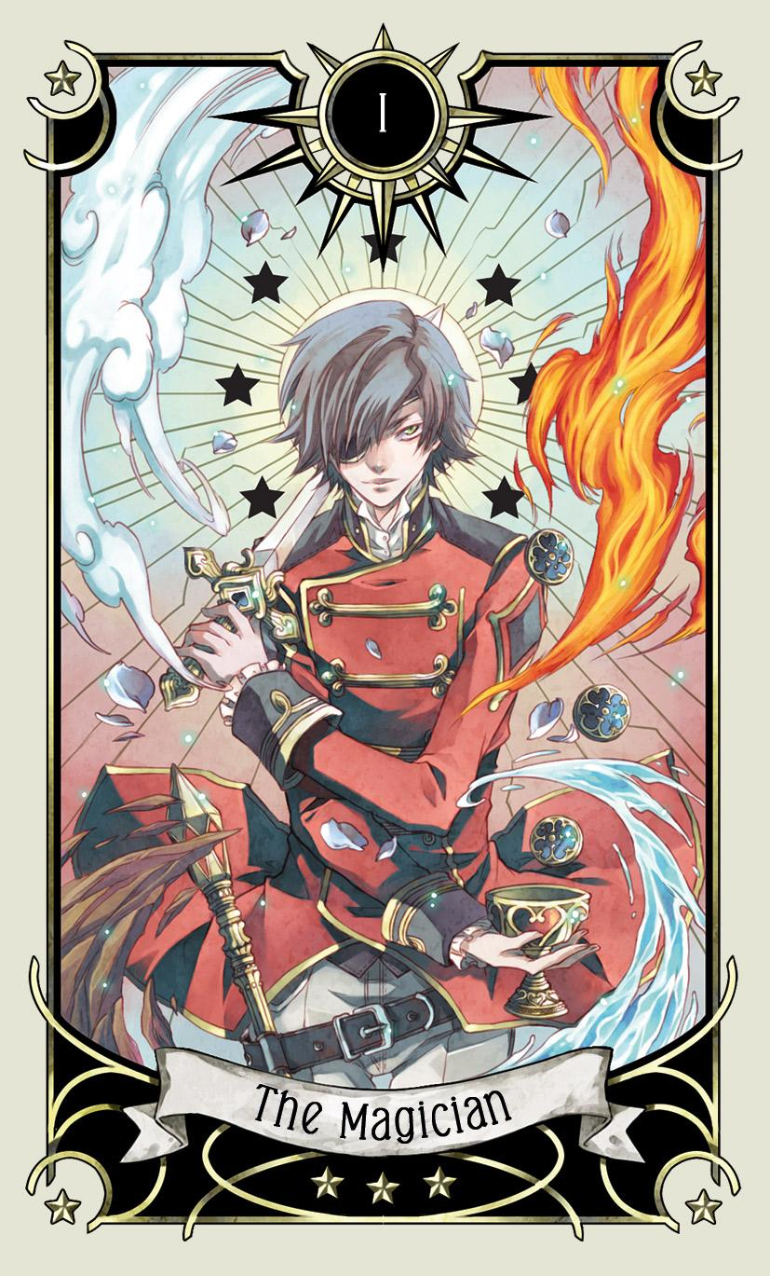
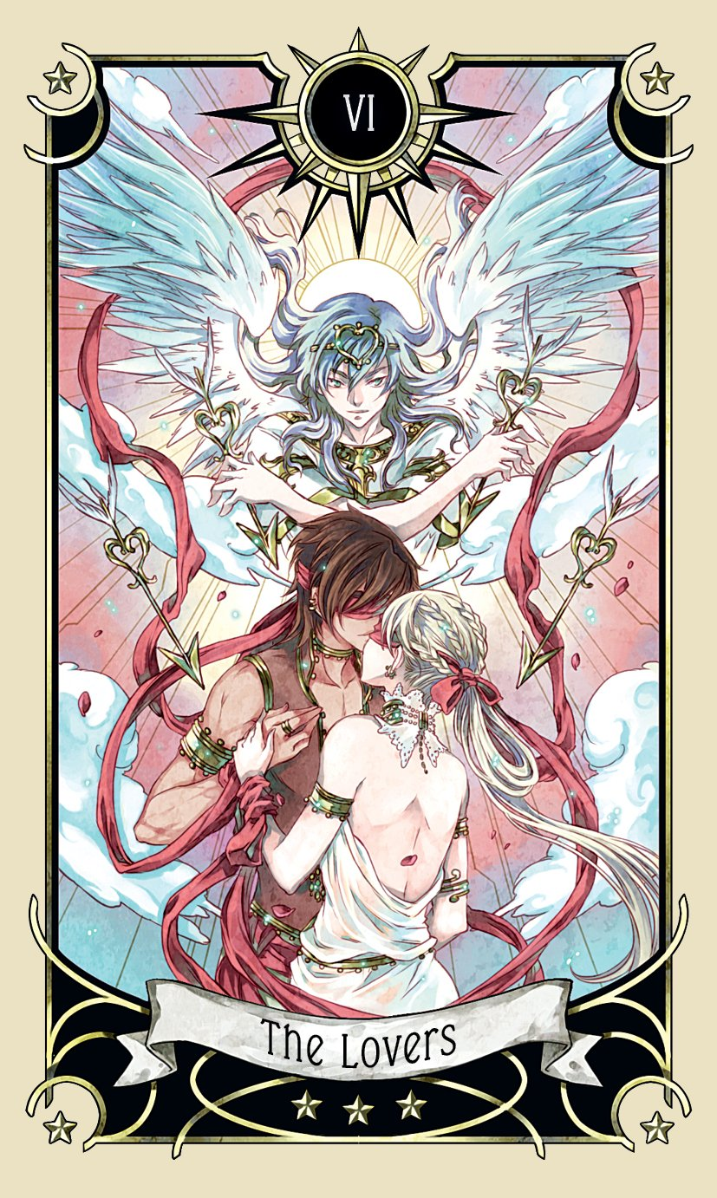
Tarot Cards
Sophisticated symbolism
Meaningful coloration
Adherence to established symbols
Emotional evocation through visual communication
Differentiation through art styles and themes
Mystical Manga Tarot - Rann

Slide 3
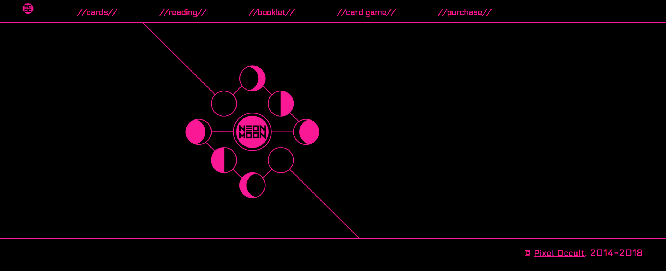
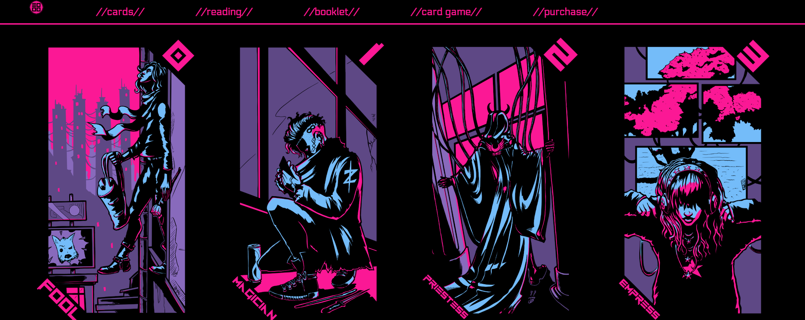
Pixel Occult & the Neon Moon Tarot
Combines the mysticism of the object with the downtrodden attitude of the subject matter
Maintains readability and impression through very simple shapes whilst communicating the thematic aesthetic
Colors a world through the design

Slide 4

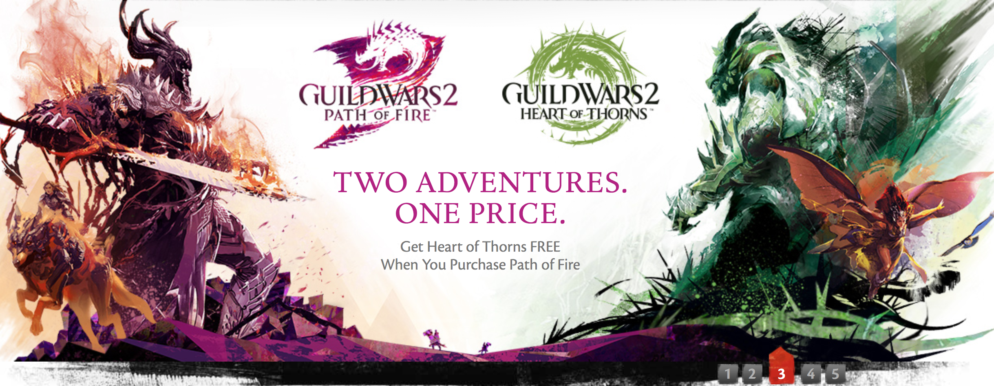
Adapts game aesthetics into tenable designs
Meshes traditional art styles with digital elements and interface
Channels energy to guide the eye through the page

